Slide 1
Communication Part 3A Assignment: Design and submit the slide deck
(5 Simple Ways to Make Your Home More Eco-Friendly)

Slide 2

1) Why eco friendly Home Matters ?
Eco-friendly homes help reduce carbon footprints, lower utility bills, and preserve natural resources for future generations

Slide 3
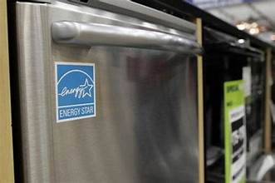
Use Energy-Efficient Appliances
Energy-efficient kitchen appliances consumes less energy and save money on utility bills.

Slide 4
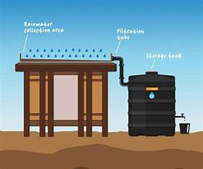
Reduce Water Usage
Collect rain water for minimal water wastage

Slide 5

Use Eco-Friendly Cleaning Products
Natural cleaning products are less harmful to the environment and reduce toxic chemicals in your home

Slide 6
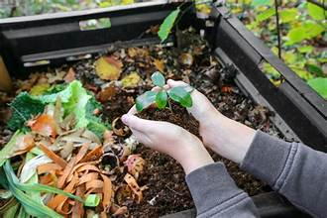
Recycle and Compost
Recycling reduces waste, and composting turns organic waste into useful fertilizer for gardens.

Slide 7
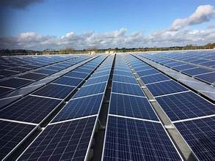
Install Solar Panels
Use solar panels for minimal wastage of power

Slide 8

Benefits of Eco-Friendly Living
Lower utility bills, cleaner environment, healthier lifestyle, and reduced carbon footprint.

Slide 9
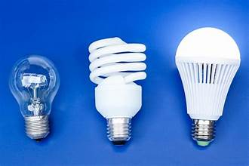

How to Get Started
Start by making small changes: switch to energy-efficient light bulbs, recycle, and reduce water use.

Slide 10
Conclusion
Making small eco-friendly changes in your home can lead to big environmental impacts over time.

